Slide 1
Cloud-native .NET Application on Azure Pack
It is not only possible, it is required. Are you ready?

Slide 2
Agenda
Introduce you to practices, Azure pack and tools for building modern .NET applications.

Slide 3
Why do you need to be good at software
Customers expects it. | Meet demand to operate at scale. | Gives you more business options. | Your competitors are doing it. | It makes everyone happier.

Slide 4
Ok, but how do I know that I’m doing well at software?
Improved speed. Faster cycle time, more frequently deployments.
Improved scale. More requests per second to apps and services.
Improved stability. Greater uptime of customer-facing service.
Improved security. Achieving 100% patch coverage.
Improved simplicity. Reduce complexity of processes and tools.

Slide 5
What are microservices?
It refers to an architectural style that supports constant change in your environment. This is accomplished by creating applications our of independent, loosely-coupled, domain-oriented services.
Moving to microservices? Here’s what to consider. | Do you have a pressing reason to do it?
 | Can you rearrange your teams?
 | Are you ready to decompose your monoliths?
 | How will you decompose?
 | Are you currently doing CI/CD ?
 | Is your production environment automated?
 | How will you discover services at runtime?
 | What can you do to prevent cascading failures?
 | Are you ready to evolve your data platforms?
 | Do you need to modernize your messaging and event stream processing toolchain?

Slide 6
What is cloud-native all about?
This is an approach to building and operating software that takes advantage of the cloud-computing model. Often seen as a combination of microservices, continuous delivery, containers, and DevOps.
It’s all about software that’s built for scale, built for continuous change, built to tolerate failure, built for manageability.

Slide 7
Most cloud-native applications comply with the 12 factor criteria.
One codebase tracked in version control
Explicitly declared dependencies
Configuration stored in the environment
Backing services treated as attached resources
Separate build, release, and run stages
Apps executed via port binding
Scaled out via more processes
Fast startup and graceful shutdown
Parity among dev, staging, and production environments
Logs treated as event stream

Slide 8
There is a maturity model to cloud native
Cloud Ready
Cloud Friendly
Cloud Resilient
Cloud Native
No File System Dependency
Self contained application
Platform managed ports/address
Consume off-platform services
Twelve factor app
Horizontal scalable
Leverage Platform for HA
Designed for failure
Apps unaffected by dependencies
Proactive failure testing
Metrics and monitoring baked in
Cloud agnostic runtime
Microservices architecture
API-first design

Slide 9
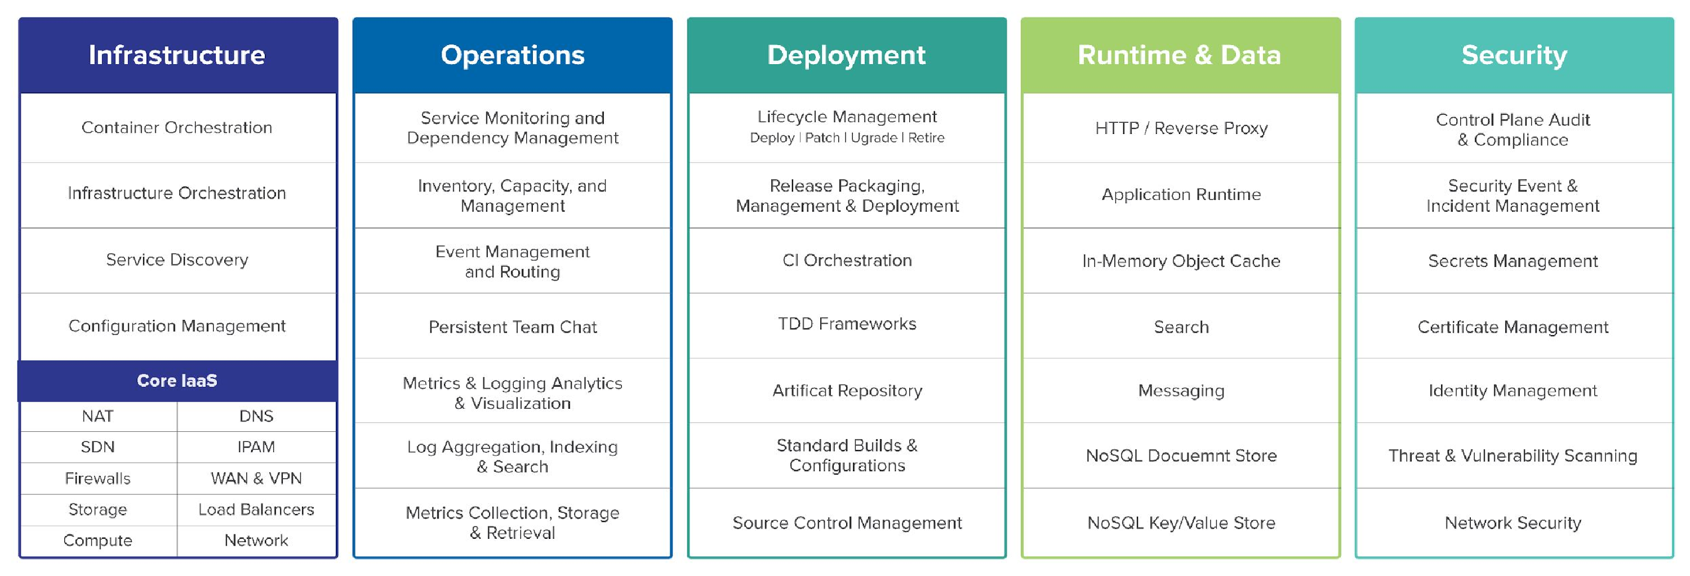
So, What actually makes up a cloud-native platform?

